Slide 1
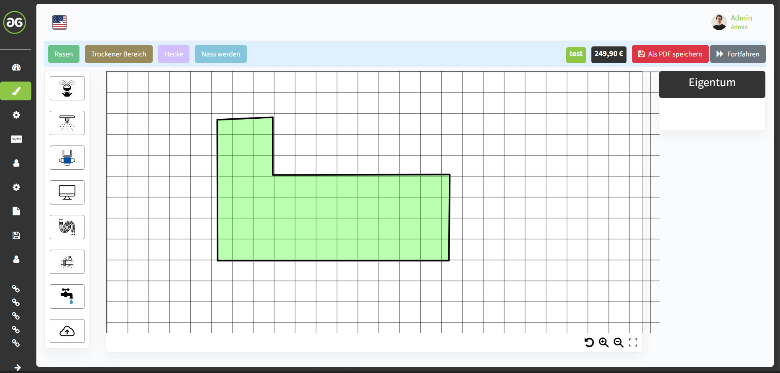

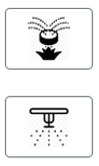





Option can be deleted
What does that mean?
Not sure, if that is is needed
The chronological order should look like shown here
and fits better to the calculations, needs to be done,
see video explanation.
Option must be added for hedge irrigation
Drip-line

Slide 2
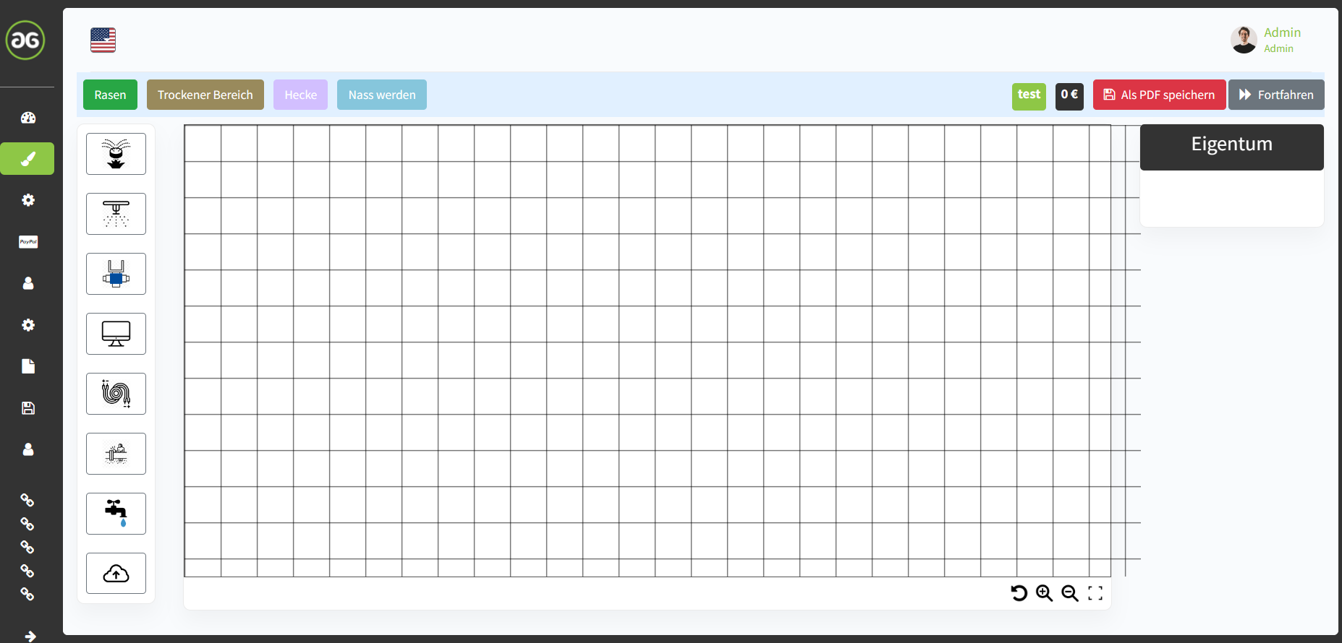
Push „lawn“, „dry area“ or „hedge“ to start sketch

Slide 3
Push „lawn“, „dry area“ or „hedge“ to start sketch

Slide 4
Push „lawn“, „dry area“ or „hedge“ to add to sketch or add „water source“

Slide 5
Push „lawn“, „dry area“ or „hedge“ to add to sketch or add water source

Slide 6
- If customer choose „well water“ or „rain water“ -
Push „Sprinkler“ to position the sprinklers
Put in output of your water source in ___ m³/h
Information of common output:
Well Water and Rain Water:
1,5m³/h – 3,0m³/h

Slide 7
- If customer choose „drinking water“-
Push „Sprinkler“ to position the sprinklers
Put in output of your water source in ___ m³/h
Information of common output:
Drinking water: 0,8m³/h - 2m³/h
Attention:
Drinking water source requires a drinking water separation station acc. to DIN EN1717

Slide 8
Push „Sprinkler“ to position the sprinklers or push „valve box“
Information:
Total output of sprinklers:
_________m³/h
Min. quantity of irrigation circles needed:
_________

Slide 9
Push „PE Pipeline“ to sketch the irrigation circles

Slide 10
Push „PE Pipeline“ to sketch the irrigation circles
Information:
Sketch connection of water source to valve box first
You need min.
________
PE pipeline circles

Slide 11
Push „PE Pipeline“ to sketch the irrigation circles or push „irrigation computer“
Information:
Total output current circle:
_________m³/h
You need min.
________
PE pipeline circles
Total length current circle:
_________m

Slide 12
Push „PE Pipeline“ to sketch the irrigation circles or push „irrigation computer“
Information:
Total output current circle:
_________m³/h
You need min.
________
PE pipeline circles
Total length current circle:
_________m

Slide 13
Push „irrigation wiring“ to sketch the irrigation wires
Information:

Slide 14
Push „Drip line“, „Proceed“ to go to bill of material and order or „Save plan as PDF“
Information:
Total length of wire:
_________m

Slide 15
Push „Proceed“ to go to bill of material and order or „Save plan as PDF“
Information:
Information:
Total length of drip line:
_________m
Drip-line

Slide 16
Push „Proceed“ to go to bill of material and order or „Save plan as PDF“
Information:
Information:
Sketch connection of drip line to valve box first
Total length of drip line:
_________m
Drip-line

Slide 17
Push „Proceed“ to go to bill of material and order or „Save plan as PDF“
Information:
Information:
Sketch connection of drip line to valve box first
Total length of drip line:
_________m
Drip-line

Slide 18
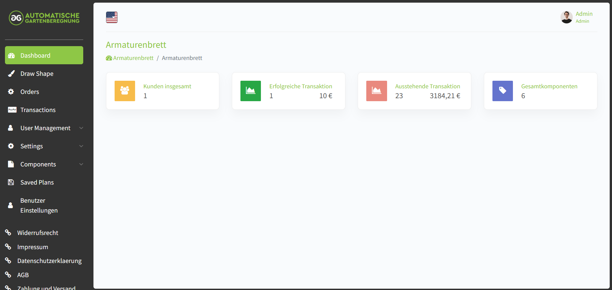
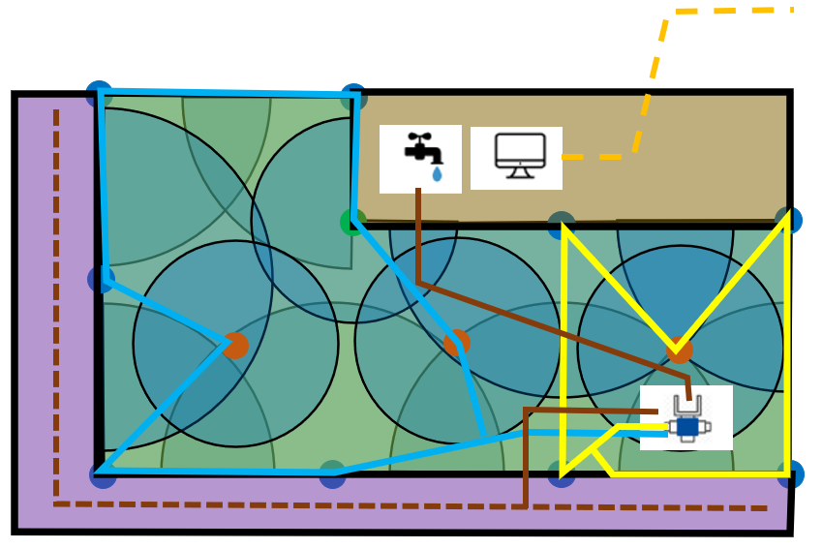
Distance Y
Logo at the top and center
Overview
Whole plan has to be shown
zoomed in and limited by
Outer shape represented here
With black border line
Water Source output: ___ m³/h
Quantity of irrigation circles: ___
Distance X
Distance X
Number of Sprinklers: ___
Total PE pipeline length: ___
Total Drip line length: ___
Distance Y

Slide 19
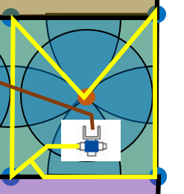
Detail Circle 1

Slide 20
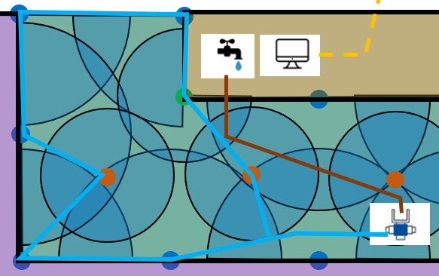
Detail Circle 2

Slide 21
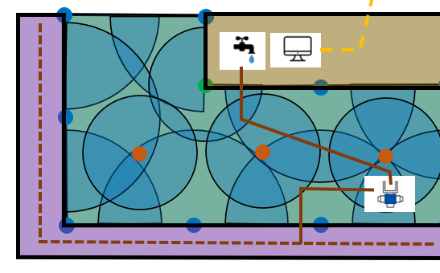
Detail Circle 3

Slide 22
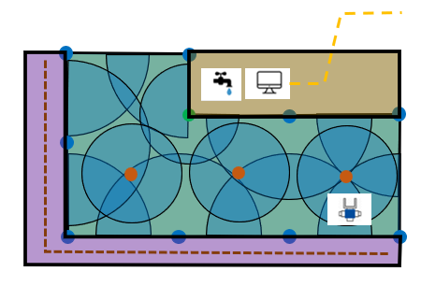
Dimensions
10m
10m
10m
10m
10m
10m
10m
10m
10m
10m
10m
10m
10m
10m
10m
10m

Slide 23
Sprinkler Overview
MP3000 90
MP3000 90
MP2000 270
MP3000 90
MP3000 90
MP3000 90
MP2000 360
MP2000 360
MP2000 360
MP3000 90
MP3000 90
MP3000 90
MP3000 90

Slide 24
Logo at the top and center
T
T
Connector Overview
E
T
T
T
T
T
T
T
T
T
T
T
T
T
t
E

Slide 25
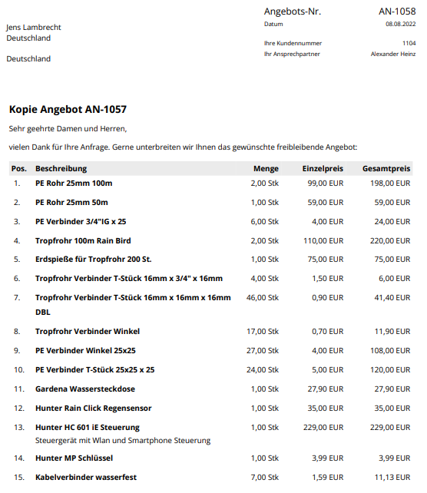
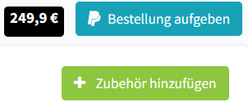
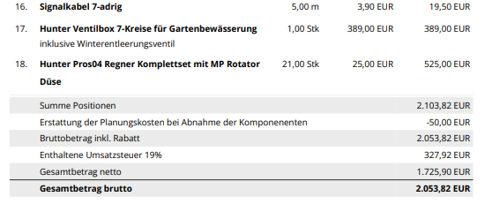
Offer

Slide 26
Push „lawn“, „dry area“ or „hedge“ to start sketch

Slide 27
Push „lawn“, „dry area“ or „hedge“ to start sketch
Scaling process of the planner to adjust Image to same scale as planner:
Information:
Please define scale by clicking onto start end end point of a known length in uploaded Image
End point picked by customer
Input by customer
Define length of selected line:
_________m
Start point picked by customer
By clicking the „image upload“ button, customer implements skech to drawing to which scale at that moment is not known for planner

Slide 28
Push „lawn“, „dry area“ or „hedge“ to start sketch

Slide 29
Push „lawn“, „dry area“ or „hedge“ to add to sketch or add „water source“

Slide 30
Push „lawn“, „dry area“ or „hedge“ to add to sketch or add water source

Slide 31
- If customer choose „well water“ or „rain water“ -
Push „Sprinkler“ to position the sprinklers
Put in output of your water source in ___ m³/h
Information of common output:
Well Water and Rain Water:
1,5m³/h – 3,0m³/h

Slide 32
- If customer choose „drinking water“-
Push „Sprinkler“ to position the sprinklers
Put in output of your water source in ___ m³/h
Information of common output:
Drinking water: 0,8m³/h - 2m³/h
Attention:
Drinking water source requires a drinking water separation station acc. to DIN EN1717

Slide 33
Push „Sprinkler“ to position the sprinklers or push „valve box“
Information:
Total output of sprinklers:
_________m³/h
Min. quantity of irrigation circles needed:
_________

Slide 34
Push „PE Pipeline“ to sketch the irrigation circles

Slide 35
Push „PE Pipeline“ to sketch the irrigation circles
Information:
Sketch connection of water source to valve box first
You need min.
________
PE pipeline circles

Slide 36
Push „PE Pipeline“ to sketch the irrigation circles or push „irrigation computer“
Information:
Total output current circle:
_________m³/h
You need min.
________
PE pipeline circles
Total length current circle:
_________m

Slide 37
Push „PE Pipeline“ to sketch the irrigation circles or push „irrigation computer“
Information:
Total output current circle:
_________m³/h
You need min.
________
PE pipeline circles
Total length current circle:
_________m

Slide 38
Push „irrigation wiring“ to sketch the irrigation wires
Information:

Slide 39
Push „Drip line“, „Proceed“ to go to bill of material and order or „Save plan as PDF“
Information:
Total length of wire:
_________m

Slide 40
Push „Proceed“ to go to bill of material and order or „Save plan as PDF“
Information:
Information:
Total length of drip line:
_________m
Drip-line

Slide 41
Push „Proceed“ to go to bill of material and order or „Save plan as PDF“
Information:
Information:
Sketch connection of drip line to valve box first
Total length of drip line:
_________m
Drip-line

